Slide 1





ASP.NET MVC Advanced Topics
Developing high-quality web application
SoftUni Team
Technical Trainers
Software University
http://softuni.bg

Slide 2


Table of Contents
Request Pipeline
Global Solutions
Removing Magic Strings
Services Layer & Dependency Inversion
Models
AutoMapping different models
Custom ModelBinders and ModelBinderProviders
Controllers
Custom ActionResults, Populators, Filters, Cache
Views
Editor and Display templates
HTML Tags and Custom helpers
Unit Testing Frameworks

Slide 3

Request Pipeline

Slide 4
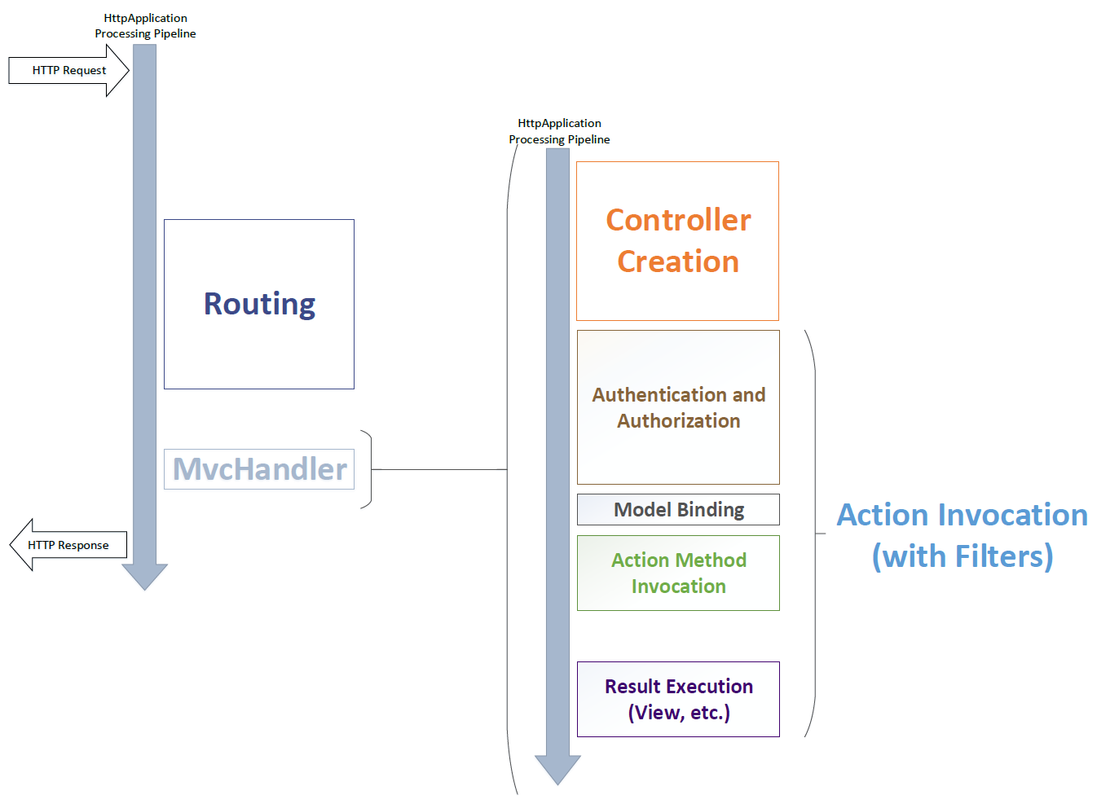
MVC Request Lifecycle

Slide 5
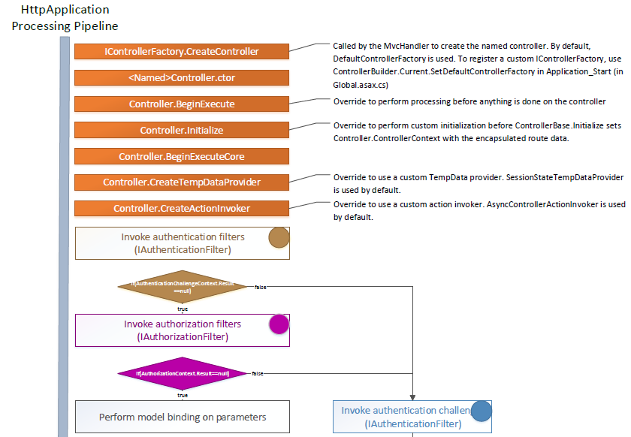
MVC Handler Lifetime

Slide 6
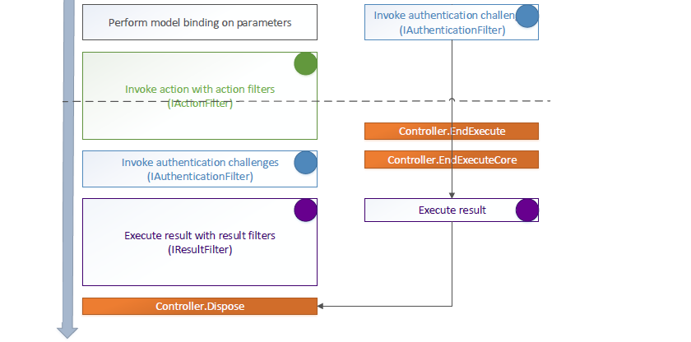
MVC Handler Lifetime (2)

Slide 7
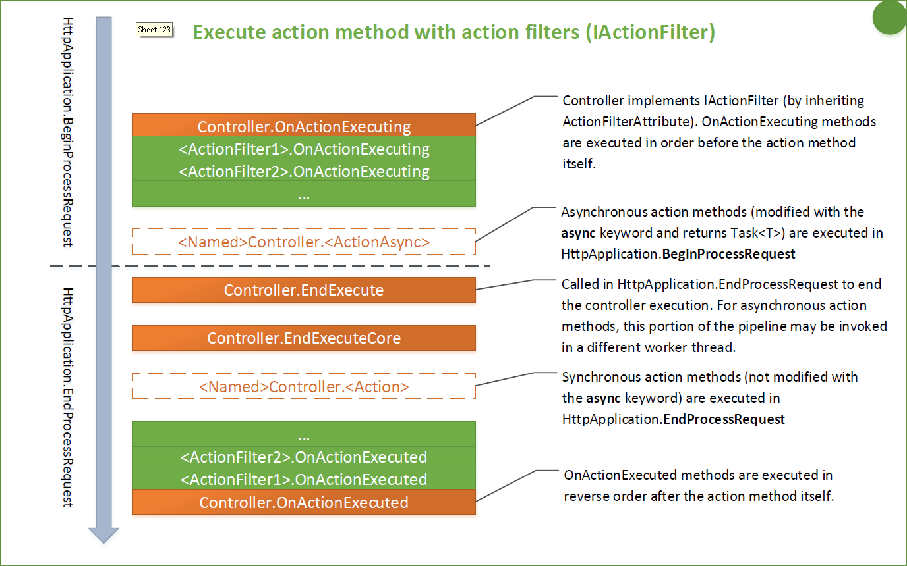
Action Method Execution

Slide 8
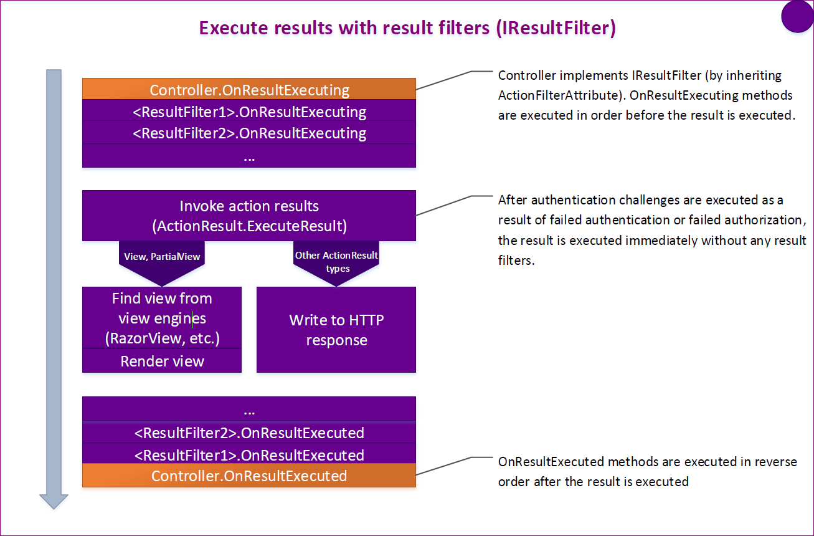
Execute Results

Slide 9

Global Solutions For Global Problems

Slide 10
Magic Strings
In ASP.NET MVC magic strings play huge role
Redirect results
Render custom views and partial views
Custom templates
Html, Ajax and Url helpers
return RedirectToAction("Index", "Home");
Html.Partial("_StatisticsPartial");
Url.Action("Index", "Home", new { id = 5 });
Ajax.BeginForm("Save", "Products");

Slide 11
Magic Strings
Solution
Create special place for constants and group them
Create custom methods taking Lambda expressions
Or use System.Web.Mvc.Expressions package
return RedirectToAction<HomeController>(c => c.Index());
Html.Partial(Partials.Statistics);
Url.Action<HomeController>(c => c.Index(), new { id = 5 });
Ajax.BeginForm<ProductsController>(c => c.Save());

Slide 12
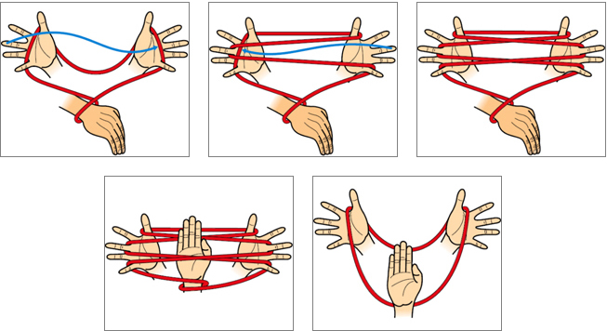
Magic Strings
Live Demo

Slide 13
Services Layer
Often controllers have quite a lot of logic
Caching objects
Background tasks
Identity tasks
Database queries
Posted files logic
and many more…
So called "fat" controller

Slide 14
Services Layer
Solution
Define interface for each "worker"
ICacheService
IPostedFilesService
IProductsDataService
etc.
Make implementations and use them in the controllers

Slide 15
Services Layer
Before
After
var product = this.dbContext.Products
.Where(pr => pr.Title.Contains(title))
.OrderByDescending(pr => pr.CreateOn)
.Take(pageSize)
.Skip(page)
.ToList();
var product = productsData
.FindByTitle(title, page)
.ToList();

Slide 16

Services Layer
Live Demo

Slide 17

Dependency Inversion
Don't instantiate dependencies through out the actions
public ActionResult Products(int page)
{
var db = new ApplicationDbContext();
var productsData = new ProductsDataService(db);
…
}

Slide 18

Dependency Inversion
Put them into the controller constructor as interfaces and "inject" them from outside
public ProductsController(
IProductsDataService productsData,
ICacheService cache)
{
this.productsDataService = productsData;
this.cacheService = cache;
}

Slide 19
Dependency Inversion
But who will "inject" the dependencies?
Install an Inversion of Control Container (IoC)
Ninject
Ninject.MVC and Ninject.Extensions.Conventions
StructureMap
Register bindings there
kernel.Bind<IDbContext>().To<MySystemDbContext>().InRequestScope(); kernel.Bind(typeof(IRepository<>)).To(typeof(EfRepository<>)); kernel.Bind<IUoWData>().To<UoWData>();

Slide 20
Dependency Inversion
Use NinjectWebCommon
To start the registration
To override default controller factory
Use Ninject.Extensions.Conventions
To create custom conventions
kernel.Bind(k => k.FromAssemblyContaining<IService>()
.SelectAllClasses()
.BindDefaultInterface()
.Configure(b => b.InRequestScope()));

Slide 21

Dependency Inversion
Live Demo

Slide 22

Models
High-Quality Models

Slide 23
Mapping Objects
In many cases we need to
Get an database object
Take only the data we need
Pass it to the view/response
var viewModel = new ProductViewModel
{
Id = model.Id,
Name = model.Name,
Price = model.Price,
Orders = model.Orders.Count(o => o.Type == Pending)
}

Slide 24

Mapping Objects
Mapping code
Can be annoying
Takes time
Error prone
No single place for mapping
AutoMapper to the rescue!
Automates the mapping process
https://github.com/AutoMapper/AutoMapper

Slide 25
Mapping Objects
AutoMapper
Maps by name
Supports flattening
Supports collections
Conditional mapping
Type conversions
Many more

Slide 26
Mapping Objects
Default functionality
Map source to destination type
Get the mapped object
Or use the AutoMapper.QueryableExtensions
Mapper.CreateMap<Product, ProductViewModel>();
var viewModel = Mapper.Map<ProductViewModel>(model);
var prs = this.productsData.FindByTitle(title, page)
.Project()
.To<ProductViewModel>()
.ToList();

Slide 27
Mapping Objects
Where to create mappings and bootstrap them?
Create a AutoMapperConfig
Create IMapFrom<T> and IHaveCustomMappings
Using reflection get all types implementing the interfaces and map the objects
Using Mapper.CreateMap for IMapFrom<T>
Using Mapper.Configuration for IHaveCustomMappings

Slide 28
AutoMapper
Live Demo

Slide 29
ModelBinderProvider
In many cases we need to
Pass an "id" to the action
Get the object with that id from the data layer
Pass it to the view
public ActionResult Product(int id)
{
var product = this.productsData.GetById(id);
var vModel = Mapper.Map<ProductViewModel>(product);
return View(vModel);
}

Slide 30
ModelBinderProvider
With custom model binders we can directly
Bind the product
Don’t get it by "id" every time
public ActionResult Product(Product product)
{
var vModel = Mapper.Map<ProductViewModel>(product);
return View(vModel);
}

Slide 31
ModelBinderProvider
Create the generic model binder
public class EntityModelBinder<T> : IModelBinder
where T : Entity
{
private readonly IRepository<TEntity> repo;
public EntityModelBinder(IRepository<T> repo)
{
this.repo = repo;
}
… continues on next slide

Slide 32
ModelBinderProvider
Create the generic model binder
…
public object BindModel(ControllerContext controllerContext,
ModelBindingContext bindingContext)
{
var value = bindingContext.ValueProvider.GetValue("id");
var id = int.Parse(value.AttemptedValue as string);
var entity = this.repository.GetById(id);
return entity;
}
}

Slide 33
ModelBinderProvider
Create the model binder provider
public class EntityModelBinderProvider : IModelBinderProvider
{
public IModelBinder GetBinder(Type modelType)
{
// check the model type and return null
Type modelBinderType = typeof(EntityModelBinder<>)
.MakeGenericType(modelType);
var modelBinder = ObjectFactory.GetInstance(modelBinderType);
return (IModelBinder)modelBinder;
}
}

Slide 34
ModelBinderProvider
Live Demo

Slide 35

Controllers

Slide 36
Base Controller
We can create abstract BaseController
Derived from MVC Controller
Containing all common information
Getting current user for example
We can create separate AjaxController
Derived from MVC Controller
AJAX requests are passed to this controller
This way all common parts are not loaded

Slide 37
Custom ActionResult
In many cases we
Have common patterns for returning results
Have model manipulation before returned
For example with AutoMapper
public ActionResult Product(Product product)
{
var vModel = Mapper.Map<ProductViewModel>(product);
return View(vModel);
}

Slide 38
Custom ActionResult (2)
Enhancement
We can create AutoMappedQueryViewResult
And this way our controllers become
Slim
Readable
Maintainable
public ActionResult Product(Product product)
{
return AutoMappedQueryView(View(product));
}

Slide 39
Custom ActionResult
Live Demo

Slide 40
Generic Cache Service
It is better to implement our own cache service
protected T Get<T>(string id, Func<T> getItemCallback) where T : class
{
var item = HttpRuntime.Cache.Get(id) as T;
if (item == null)
{
item = getItemCallback();
HttpContext.Current.Cache.Insert(id, item);
return item;
}
return item;
}

Slide 41
Generic Cache Service
Then inherit it with more specific methods
public IEnumerable<SelectListItem> Countries
{
get
{
return this.Get<IEnumerable>("Countries", () =>
this.data.Countries.All().ToList());
}
}

Slide 42
Generic Cache Service
Live Demo

Slide 43
Custom Action Filter
public class LogAttribute : ActionFilterAttribute
{
public override void OnActionExecuting(ActionExecutingContext filterContext)
{ … }
public override void OnActionExecuted(ActionExecutedContext filterContext)
{ … }
public override void OnResultExecuting(ResultExecutingContext filterContext)
{ … }
public override void OnResultExecuted(ResultExecutedContext filterContext)
{ … }
}
[Log]
public class DepartmentController : Controller { … }

Slide 44
Populators
In many cases we
Have to populate the same data on many places
DropDownList items are common example
public ActionResult Product()
{
var vModel = …;
vModel.Countries = this.cacheService.Countries;
return View(vModel);
}

Slide 45
Populators
We can create custom filter attribute
public class PopulateCountryNamesAttribute : ActionFilterAttribute
{
[Inject]
public ICacheService Cache { private get; set; }
public override void OnResultExecuting(ResultExecutingContext filterContext)
{
filterContext.Controller.ViewBag.Countries =
this.CacheService.CountriesSelectListItems;
}
}

Slide 46
Populators
Live Demo

Slide 47

Views

Slide 48

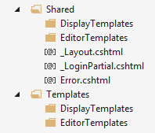
Templates
ASP.NET MVC comes with helpers methods
DisplayFor(), DisplayForModel()
EditorFor(), EditorForModel()
There are default implementation
Easily to be configured
Create folders "DisplayTemplates" and "EditorTemplates" the "Shared" folder or in the "Views/{Controller}" folder

Slide 49
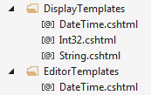
Custom Templates
In the two new folders create a view for each type you want
string -> String.cshtml
int -> Int32.cshtml
DateTime -> DateTime.cshtml
Student -> Student.cshtml
The name of the files must reflect the data types and the @model in them

Slide 50

Custom Templates
These view are normal view files
The framework will start using them instead of the default implementations
For example in the String.cshtml
Now all strings will be in paragraph element and will have quotes surrounding them
DisplayFor, EditorFor -> for properties
DisplayForModel, EditorForModel -> for model

Slide 51

Custom Templates
Passing additional information to the templates
There is an object "additionalViewData" in the helper methods as parameter
You can pass anything there as anonymous type
And get the values from the ViewData / ViewBag

Slide 52

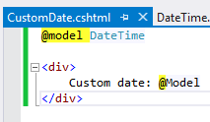
Custom Template Name
Sometimes you need two templates for one data type
Create the template with custom name
Decorate the property in the model with the UIHint attribute specifying the template name
You can set the name in the helpers too

Slide 53
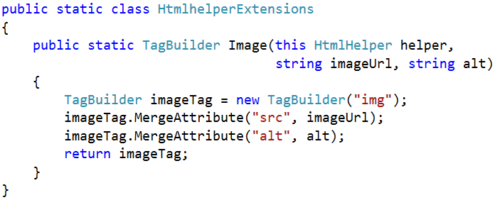

Custom HTML Helpers
Write extension methods for the HtmlHelper
Return string or override ToString method
TagBuilder manages closing tags and attributes
You can use the HTML Tags library
Add namespace in web.config (if needed)

Slide 54
HTML Tags
Install HtmlTags
You will have jQuery stile tag creation
Additional helpers will be included
public static HtmlTag TextBoxTag(this HtmlHelper html, string name)
{
return new HtmlTag("input")
.Id(name)
.Attr("name", name)
.Attr("type", "text")
.Attr("value", html.ViewData[name]);
}

Slide 55

Unit Testing

Slide 56
FluentMVC
Install TestStack.FluentMVCTesting
http://docs.teststack.net/FluentMVCTesting/usage.html
controller.WithCallTo(c => c.Index())
.ShouldRenderDefaultView()
.WithModel<ModelType>()
.AddModelErrorFor(m => m.Property1)
.ThatEquals("The error message.")
.AndModelErrorFor(m => m.Property2);

Slide 57
Unit Testing
Live Demo

Slide 58









ASP.NET MVC Advanced Topics
https://softuni.bg/courses/asp-net-mvc/

Slide 59
License
This course (slides, examples, demos, videos, homework, etc.) is licensed under the "Creative Commons Attribution-NonCommercial-ShareAlike 4.0 International" license
Attribution: this work may contain portions from
"ASP.NET MVC" course by Telerik Academy under CC-BY-NC-SA license

Slide 60





Free Trainings @ Software University
Software University Foundation – softuni.org
Software University – High-Quality Education, Profession and Job for Software Developers
softuni.bg
Software University @ Facebook
facebook.com/SoftwareUniversity
Software University @ YouTube
youtube.com/SoftwareUniversity
Software University Forums – forum.softuni.bg

